Slide 1
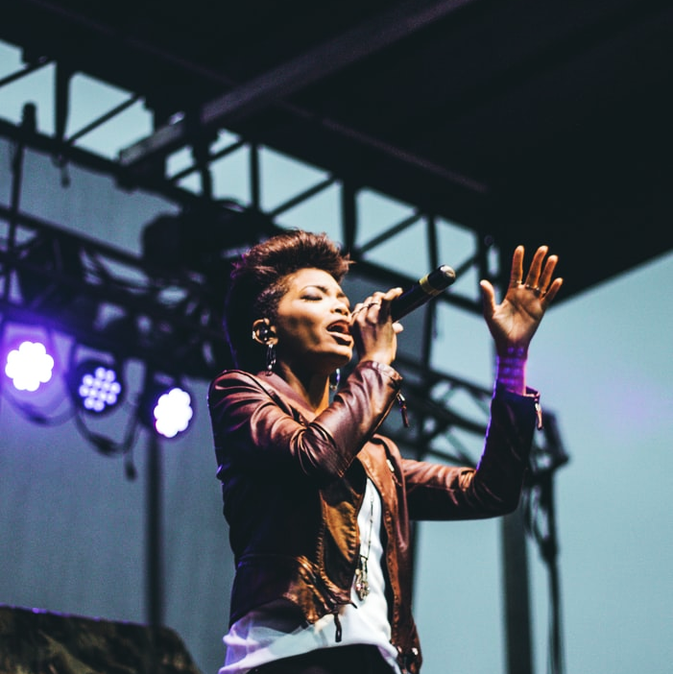
MUSIC CLASSIFIER – SINGER IDENTIFIER
G1-MusicDeciphers
Likhil Kumar Rachuri
Nandakishor Pulagam
Nirupam Kumar
Soujanya Navuluru
Vuthej Krishna

Slide 2
INTRODUCTION & DATA OVERVIEW

Slide 3
Introduction & Goals
Introduction:
It certainly is tough to identify a song which we have never heard of before. Especially with the growing number of new songs.
To ease the access of discovering and to eliminate the need to lookup and search for a song, we would build a model to identify the singer and genre of the song.
Goals:
To create a micro-service (API end-point) with below features.
Singer Identification
Recognizing the genre
Songs spanning across multiple languages
English
Hindi
Telugu

Slide 4

END TO END WORKFLOW
Mp3 File Extraction
Converting Mp3 to .wav format
Separating the vocals and instrumental music(Artists)
Feature Extraction for every 5-sec window of the input audio file.
Data standardization and dimensionality reduction.
Various Modelling techniques – language specific.
Fine tuning.
Metric evaluation and selecting the best model.
Packing the best models into pickle files.
Application development and deploying models.

Slide 5
DATA ACQUISITION & PRE-PROCESSING
Mp3 and Mp4 formats are extracted from Deezer and Jio-Saavan respectively
Converting all the formats to a single format (.wav) by using R
Spleeter module from python is used to split the song data into vocals and musicals separately.
Each wav file is divided into multiple instances of five second windows to obtain more intrinsic features.

Slide 6
Data Overview
Total 127 attributes including the target.
124 features are numerical.
‘Song_id’, ‘language’ and ‘target’ are the only categorical attributes.
Number of Data Instances for Artists Data – 13116.
Number of Data Instances for Genre Data – 9659.
TARGET VARIABLE
Singer identifier
5 English artists data (Adam Levine, drake, Justin Bieber, Selena Gomez, the Weeknd)
4 Telugu artists data (Anurag, Armaan, Geetha, Sid Sriram)
3 Hindi artists data (Arijit, Atif Aslam, Sonunigam)
Genre classification
4 English genre data (Hip-Hop Party, Rock, Romantic, Workout)
3 Telugu genre data (Rock, Romantic, Workout)
3 Hindi genre data (Rock, Romantic, Workout)

Slide 7
DATA DICTIONARY
Features | Type | Description | Example | Mean Value | Standard Deviation
song_id | object | Id of the song | Adam Levine_2XC5KXWV_0
zero_crossings | int64 | Number of zero crossings in the song | 161.499023 | 125.9319 | 21.74615
spectral_centroids_mean | float64 | mean calculated for the spectral centroids obtained | 18664 | 13895.13 | 7754.809
spectral_centroids_var | float64 | variance calculated for the spectral centroids obtained | 0.25003098 | 0.659302 | 0.130154
spectral_rolloff_mean | float64 | mean calculated for the spectral roll over obtained (85% of data) | 0.10603317 | 0.02408 | 0.025115
spectral_rolloff_var | float64 | variance calculated for the spectral roll over obtained (85% of data) | 0.70996589 | 0.489446 | 0.090789
spectral-bandwidth_mean | float64 | mean calculated for the spectral bandwidth obtained | 0.12650279 | 0.022954 | 0.010368
spectral_bandwidth_var | float64 | variance calculated for the spectral bandwidth obtained | 0.22652298 | 0.469626 | 0.129386
Spectral_contrast_mean | float64 | mean calculated for the spectral contrast obtained | 0.09311502 | 0.028363 | 0.018005
Spectral_contrast_var | float64 | variance calculated for the spectral contrast obtained | 0.2941936 | 0.560467 | 0.143964
Spectral_flatness_mean | float64 | mean calculated for the spectral flatness obtained | 0.14522232 | 0.043551 | 0.02807
Spectral_flatness_var | float64 | variance calculated for the spectral flatness obtained | 0.60158193 | 0.132647 | 0.117009
tempo | float64 | Number of beats per second | 0.2352872 | 0.033433 | 0.030523
mfcc_1_mean to mfcc_20_mean | float64 | mean value for mfcc feature 1 | 0.10672656 | [0.06,0.39] | [0.03,0.18]
mfcc_1_var to mfcc_20_var | float64 | variance value for mfcc feature 1 | 0.05563151 | [0.06,0.4] | [0.03,0.18]
chroma_stft1_mean to chroma_stft12_mean | float64 | mean value for stft feature 1 | 0.06300665 | [0.01,0.24] | [0.01,0.11]
chroma_stft1_var to chroma_stft12_var | float64 | variance value for stft feature 1 | 0.06847341 | [0.01,0.24] | [0.01,0.11]
chroma_cqt1_mean to chroma_cqt12_mean | float64 | mean value for cqt feature 1 | 0.01182739 | [-214,0.01] | [0.01,201]
chroma_cqt1_var to chroma_cqt12_var | float64 | variance value for cqt feature 1 | 0.02480159 | [-12,61] | [0.01,44]
chroma_cens1_mean to chroma_cens12_mean | float64 | mean value for cens feature 1 | 0.10915841 | [-6.9,6389] | [9.1,7183]
chroma_cens1_var to chroma_cens12_var | float64 | variance value for cens feature 1 | 2.52917933 | [0.5,1440] | [8.8,1114]
Language | Object | Language in which the song is represented. | English
Artist/genre | object | Artist or genre respectively for dataset | English_Adam Levine

Slide 8

PREDICTIVE MODELLING

Slide 9
PREDICTIVE MODELS – Previous
Model – 1: K-Nearest Neighbors (KNN)
It is a non-parametric classifier which classifies the test point based on the majority vote of these "k" nearest neighbors.
It divides data into different clusters according to the target variable.
It uses different types of distance calculating mechanisms.
Model – 2: Support Vector Machine (SVM)
Can be used for regression and classification tasks where number of features are treated as dimensions for plotting data-points.
It is built based on discovering a line/hyperplane that best divides the data-points into their respective classes.
It uses different types of line plotting mechanisms.
Issue Encountered : Regional Languages were not performing well.

Slide 10
CHANGES
Customized models were assigned to each language to make use of the respective data
Feature selection using feature importance and PCA are applied for all the 124 features with respect to each language dataset
Grid Search and Hyper parameter tuning were applied for individual models and it effectively improved.
Tried Ensemble model using voting classifier and implementing FCN

Slide 11
PREDICTIVE MODELS
Model – 3: Voting Classifier(KNN and SVC)
It is an ensemble classifier which is considering both SVC and KNN for each data instance.
Accuracy is the factor that decides the value to select from SVC or KNN.
Advantages from both the models are considered together.
Model – 4: Fully Connected Network (FCN)
Series of fully connected layers that connect each neuron with other.
Not feeding the images, rather giving the 80+ obtained features as inputs.
They are structure agnostic, no special assumptions needed on the input.

Slide 12
Pseudo Code for FCN
Input 81 features for 81 neurons in the input layer.
For i in layers:// i= each hidden layer in the network
Compute neuron activation// RELU activation function is used in the hidden layers
The respective feed forward propagation happens.
Converts the high dimensional space to low dimensional in each hidden layer.
Output layer with activation function as SoftMax with optimizer as rmsprop. Loss function: categorical cross entropy.
Return the respective predicted category from the output layer

Slide 13
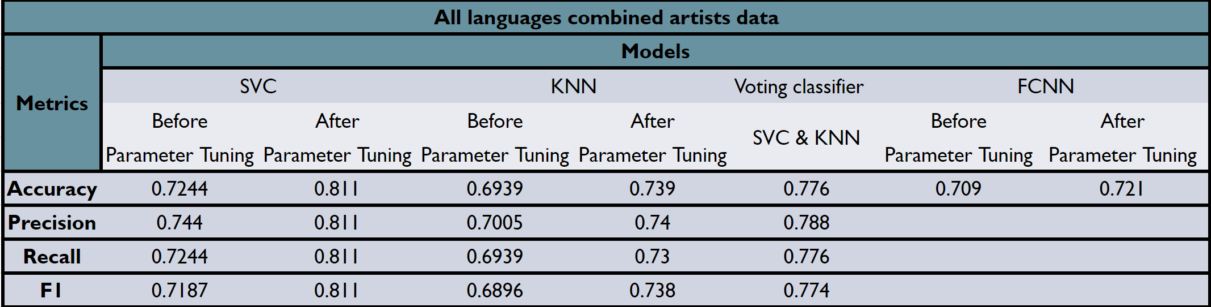
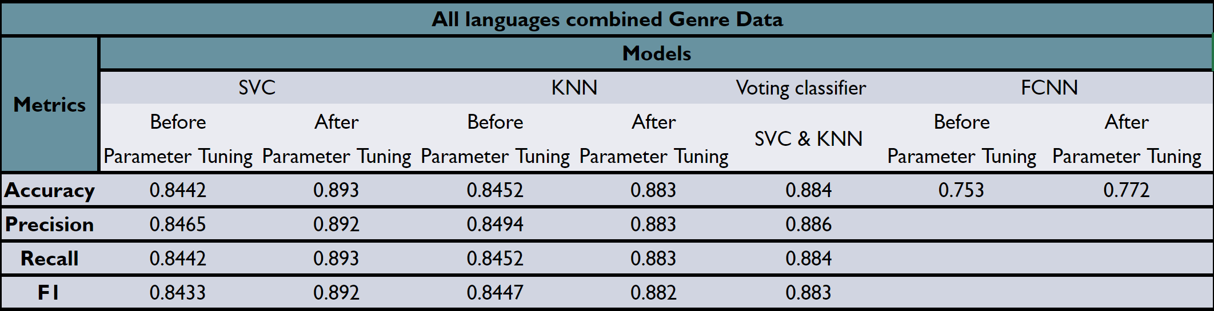
Metric Evaluation (All Languages Combined)
Artists Data
Genre Data

Slide 14
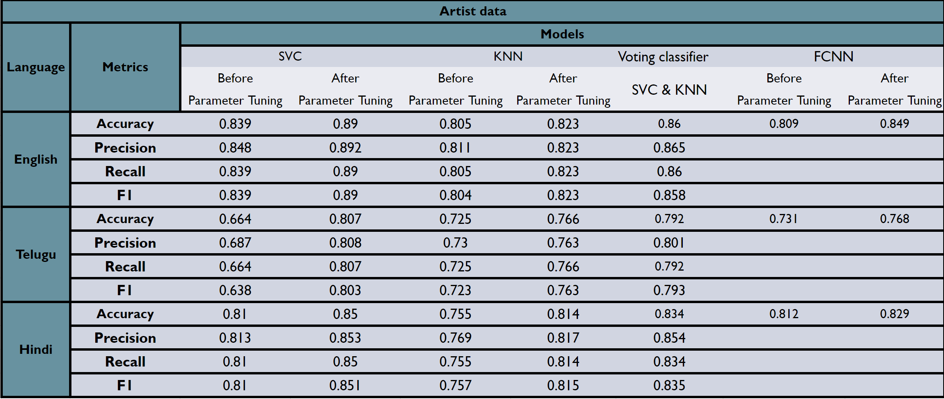

Metric Evaluation (Language Specific Classification)

Slide 15
FINAL Best Model - SVM
Artist identifier
English : {'C': 4.0, 'gamma': 'auto', 'kernel': 'rbf'}
Hindi : {'C': 2.0, 'gamma': 'auto', 'kernel': 'rbf'}
Telugu : {'C': 2.0, 'gamma': 'auto', 'kernel': 'rbf'}
All languages : {'C': 4.0, 'gamma': 'scale', 'kernel': 'rbf'}
Genre Identifier
English : {'C': 4.0, 'gamma': 'scale', 'kernel': 'rbf’}
Hindi : {'C': 4.0, 'gamma': 'auto', 'kernel': 'rbf'}
Telugu : {'C': 3.0, 'gamma': 'auto', 'kernel': 'rbf'}
All languages : {'C': 4.0, 'gamma': 'auto', 'kernel': 'rbf'}

Slide 16
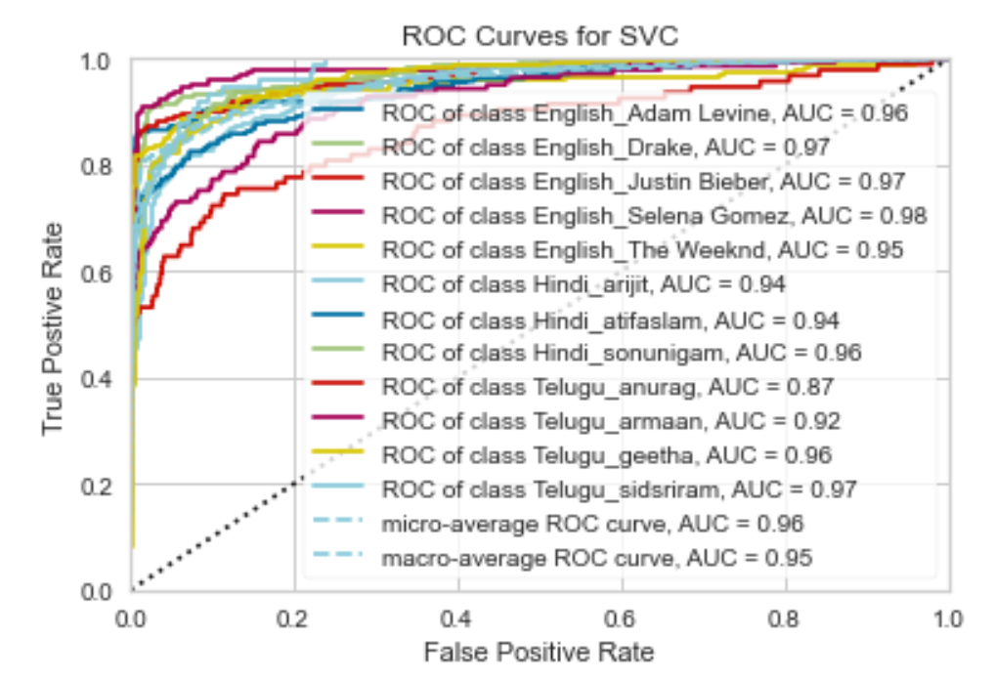
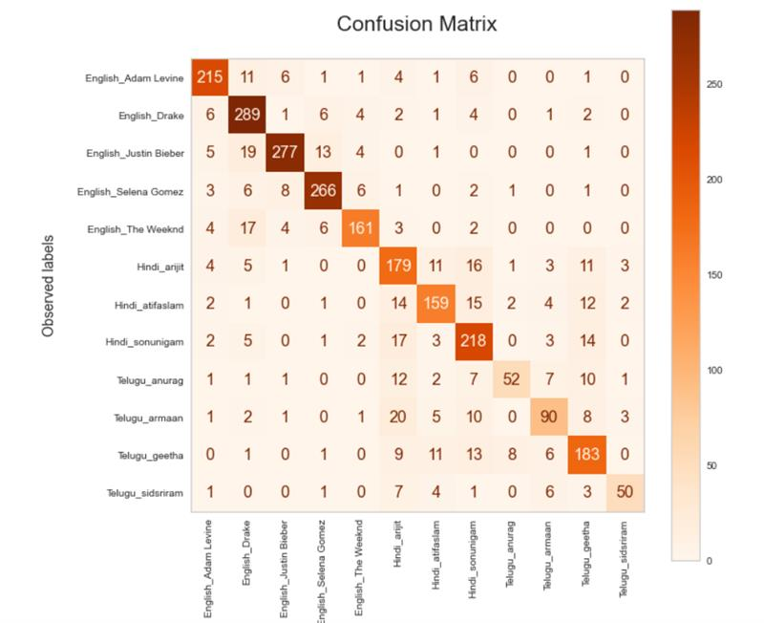
Modelling Results on Artists Data

Slide 17
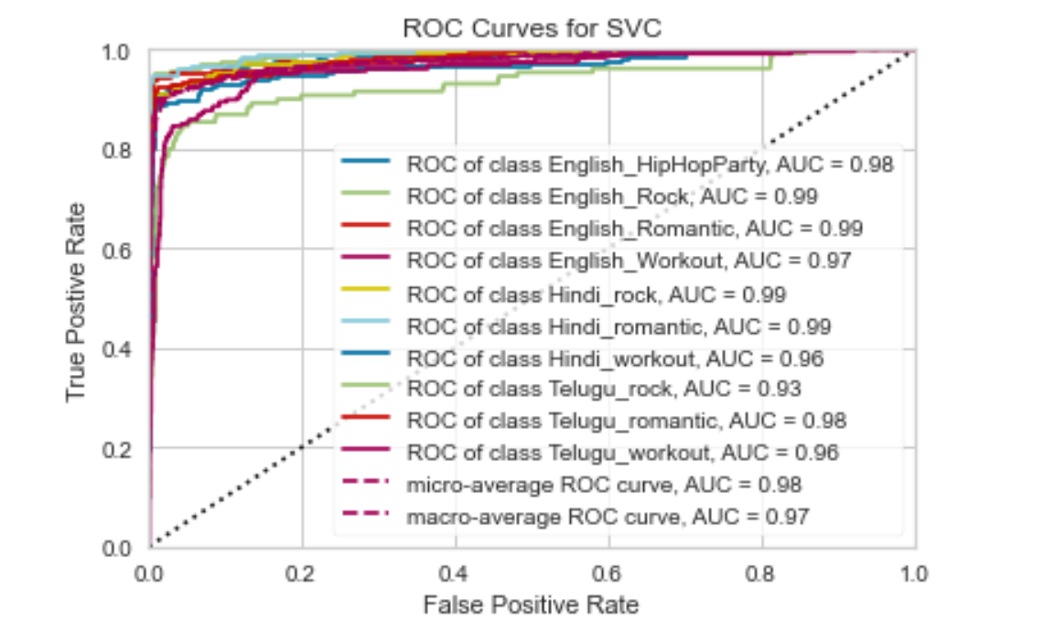
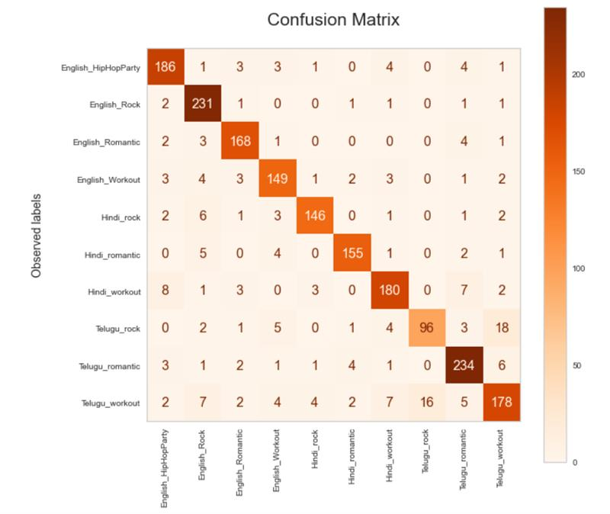
Modelling Results on Genre Data

Slide 18
Key Takeaways - Learning
Knowledge on handling the voice data.
Preprocessing and cleaning of audio waveforms.
Analysis of spectrograms.
Audio feature extraction.
Feature importance corresponding to audio wave with respect to the problem.
Various classification models including ensemble methods.
Building Neural Networks and understanding the loss functions and optimizers.
Deploying the trained models into an application.

Slide 19
Application DEMO

Slide 20
Future Scope
This POC can be extended to any further artists or genres with respect to any languages.
In case of complicated languages, training using the spectrogram images as input will effectively improve the performance.
Application can be extended with input as raw audio using microphone.
Model can be further tuned with further data to recognize the speech and speaker identification can also be implemented with minimal changes.
Model can also be applied for security purposes.

Slide 21
THANKS!!
Questions?

